Slide 1
Flu Modeling Update 10/24
https://github.com/haohu1/FluModelTest

Slide 2
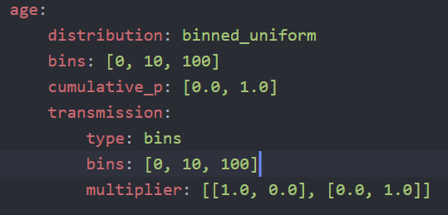
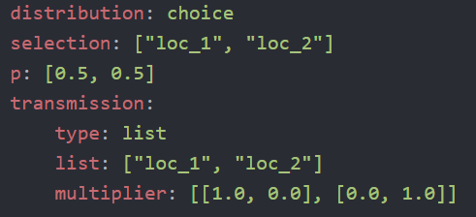
All demographics as labels
Each individuals carries a set of labels
Age, location, facilities, risk groups,…
Q: can we fix the labels given that we only use a few demographics?
Labels can be dynamically generated from distribution similar to HINT groups or age demographics, or fully customized as input (TBD)
Infectivity multiplier: interaction between labels
Age contact matrix
Commuting
Contact pattern at different times of day
TODO:
Labels generated by other scripts as input
update labels during simulation (e.g. aging)
Sub-day multipliers (e.g. household vs work)
Direct person-person network generator

Slide 3
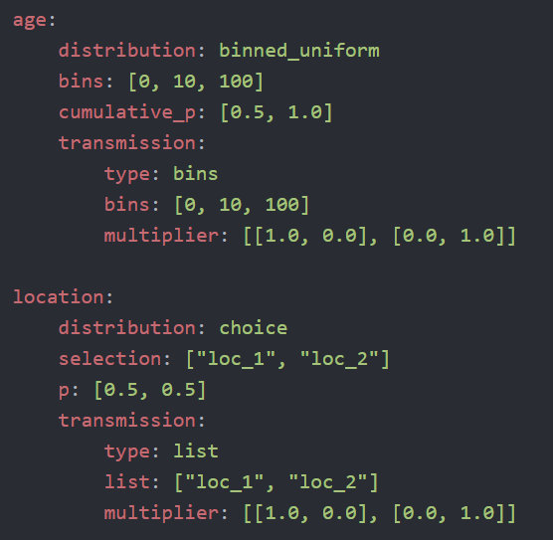
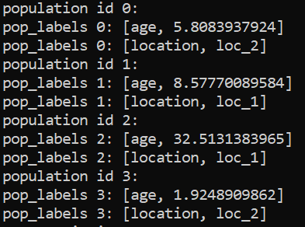
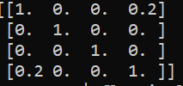
‘Matrixfy’ Transmission
Example: 4 individuals, base_infectivity = 0.2
I(t) is a list of individuals with active infection
P(t) is an individual-level probability of transmission matrix
based on labels and transmission multipliers
I(t+1) = matrix_dot( I(t), binomial(P(t)) )
Keep track of list of ‘excluded’ individuals, e.g. recovered
Can generate infection hierarchy network
P(t)

Slide 4
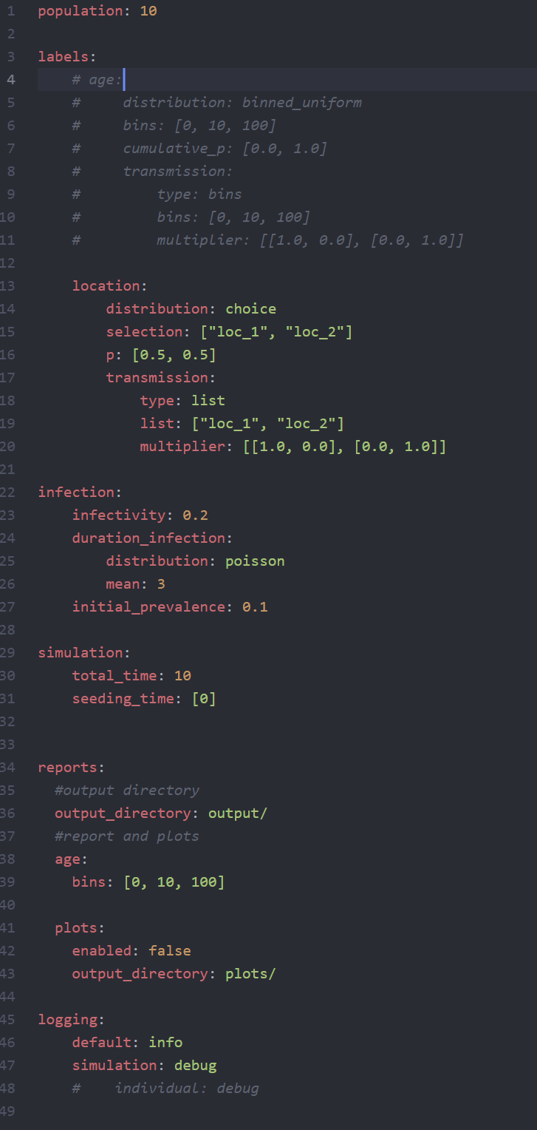
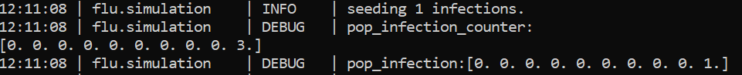
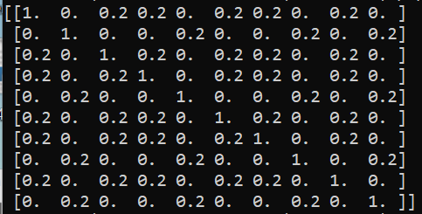
Examples: 10 individuals in 2 isolated locations
loc_1: 0, 2, 3, 5, 6, 8
loc_2: 1, 4, 7, 9
seeding: id=9
Transmission_matrix:

Slide 5
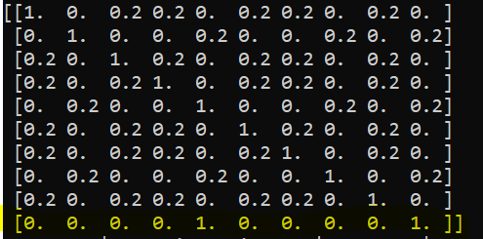
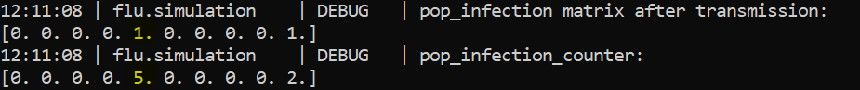
t=1
active infections: 4, 9
New infections: 4 (from 9)

Slide 6
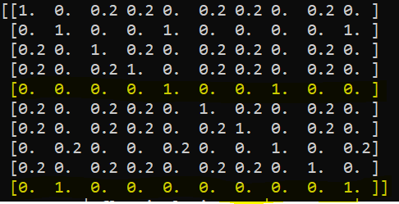
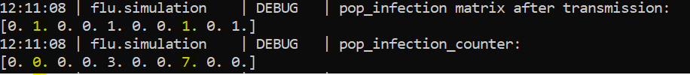
t=2
active infections: 1, 4, 7, 9
New infections: 1 (from 9), 7 (from 4)

Slide 7
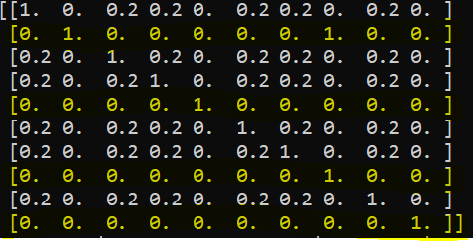
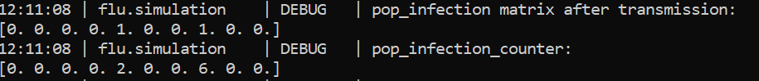
t=3
active infections: 1, 4, 7, 9
New infections: -

Slide 8
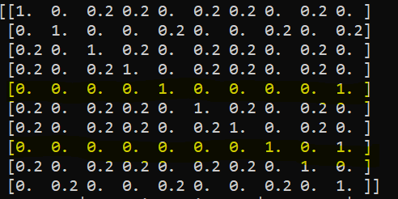
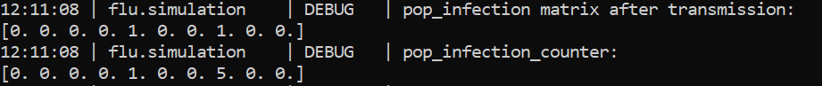
t=4
active infections: 4, 7
New infections: - (because 9 is recovered)

Slide 9
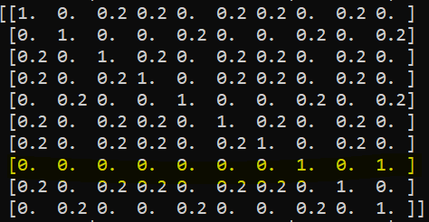
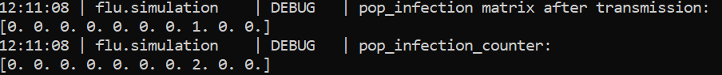
t=7
active infections: 7
New infections: -

Slide 10
Generating Infection Network

Slide 11
100 individuals… 2 locations, 2 age groups (50%)

Slide 12
1000 individuals… 2 locations, 2 age groups (50%)

Slide 13
Household / Community
10 household with ~10 per house, transmission in:out = 100

Slide 14
Increasing intrahost model complexity
S->I->R
Heterogeneous transmission (Super Infection)
Shedding over time
Multiplier change based on infection counter
Full Viral Kinetic Model
S-I-R-like model at each individual level

Slide 15
Questions
Is this on the right direction of GPU optimization?
How should we define the infectivity parameter?
Density or frequency dependent?
Do the “labels” cover all use cases?
How to extend the binary infectivity to continuous? (e.g. heterogeneity of infectiousness)
Adding genomes?

